Slide 1
0x100 – Introduction to the Introduction
ECED4406 – Computer Security
Dr. Colin O’Flynn
Dalhousie University.

Slide 2
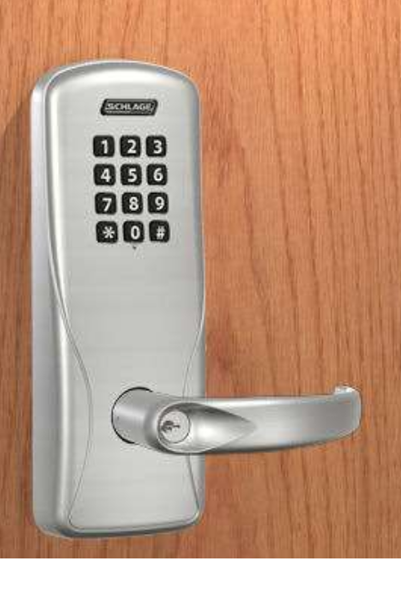
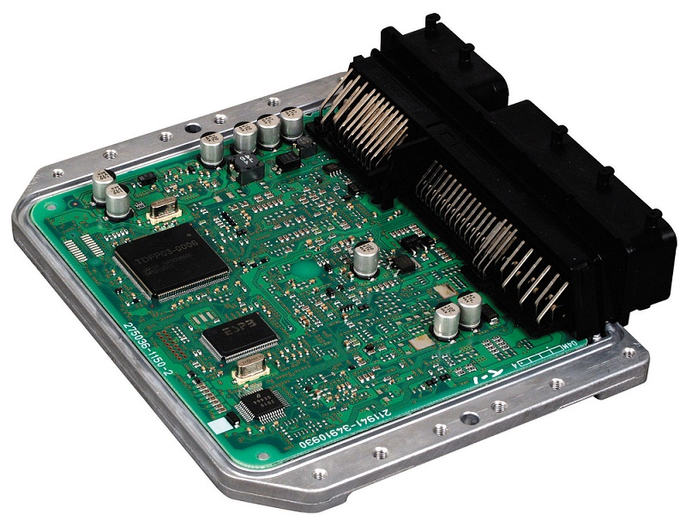
What is this course about?
Embedded system security, such as:
IOT Devices
Automotive Systems
How to secure embedded systems.
What is cryptography?
What is a root of trust, secure boot, etc?
What are security ratings?
How to break embedded systems.
Reverse engineering.
Fuzzing.
Hardware Attacks - Non-invasive.
Hardware Attacks - Invasive

Slide 3
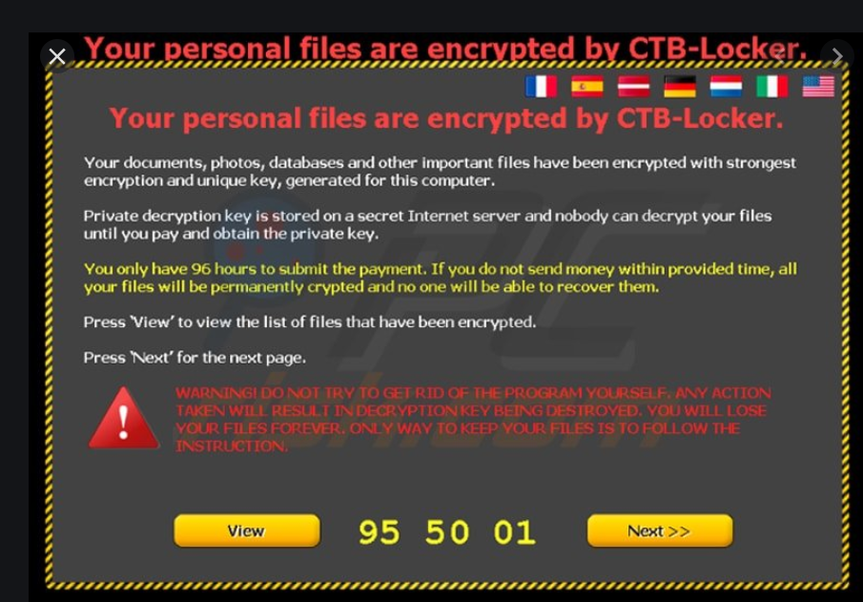

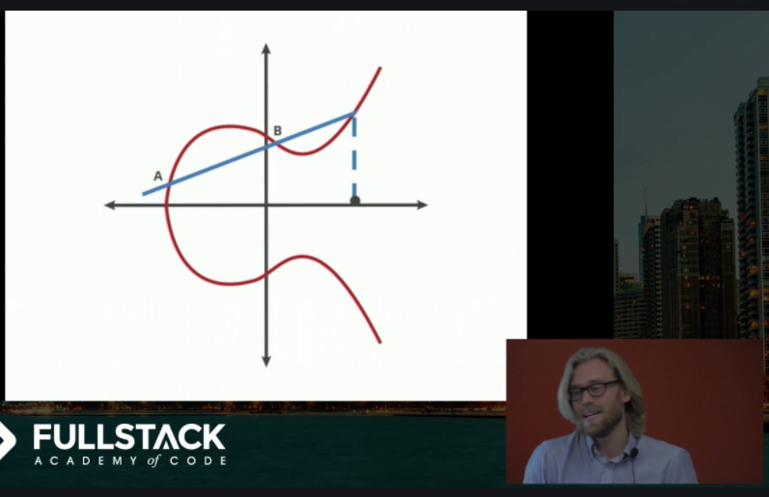
What is this course not about?
Web security & web security protocols.
HTTPS, SSL, etc.
Detail cryptographic algorithm development.
High-level application security (Windows, Linux, etc).

Slide 4
What should you already know?
The following words should mean something to you:
RAM.
ROM.
Stack frame.
Instruction registers.
Matrix multiplication.

Slide 5
Online to In Person
I previously taught this course only online. This is the first in-person edition.
Previous lectures are available (from 2020 year) at https://www.youtube.com/playlist?list=PLyAXNQGte3qNNbs8J3gE8JkpAJ9_OH75q .
Watch that some things (especially assignments/labs) may have changes this year.
Where lectures differ, I’ll record versions and try to post them.
“Lectures” were short – one class contains multiple lectures!

Slide 6
Course Lecture Style
Class schedule is roughly as follows each day:
Monday @ 10:05AM – 11:25AM
Thursdays @ 10:05AM – 11:25AM
Classes will roughly follow the schedule each day:
10:05-10:15: Recap of previous lecture (possibly longer if needed).
10:15-11:00: New material / lectures (45 mins)
11:00-11:25: Questions & discussions

Slide 7
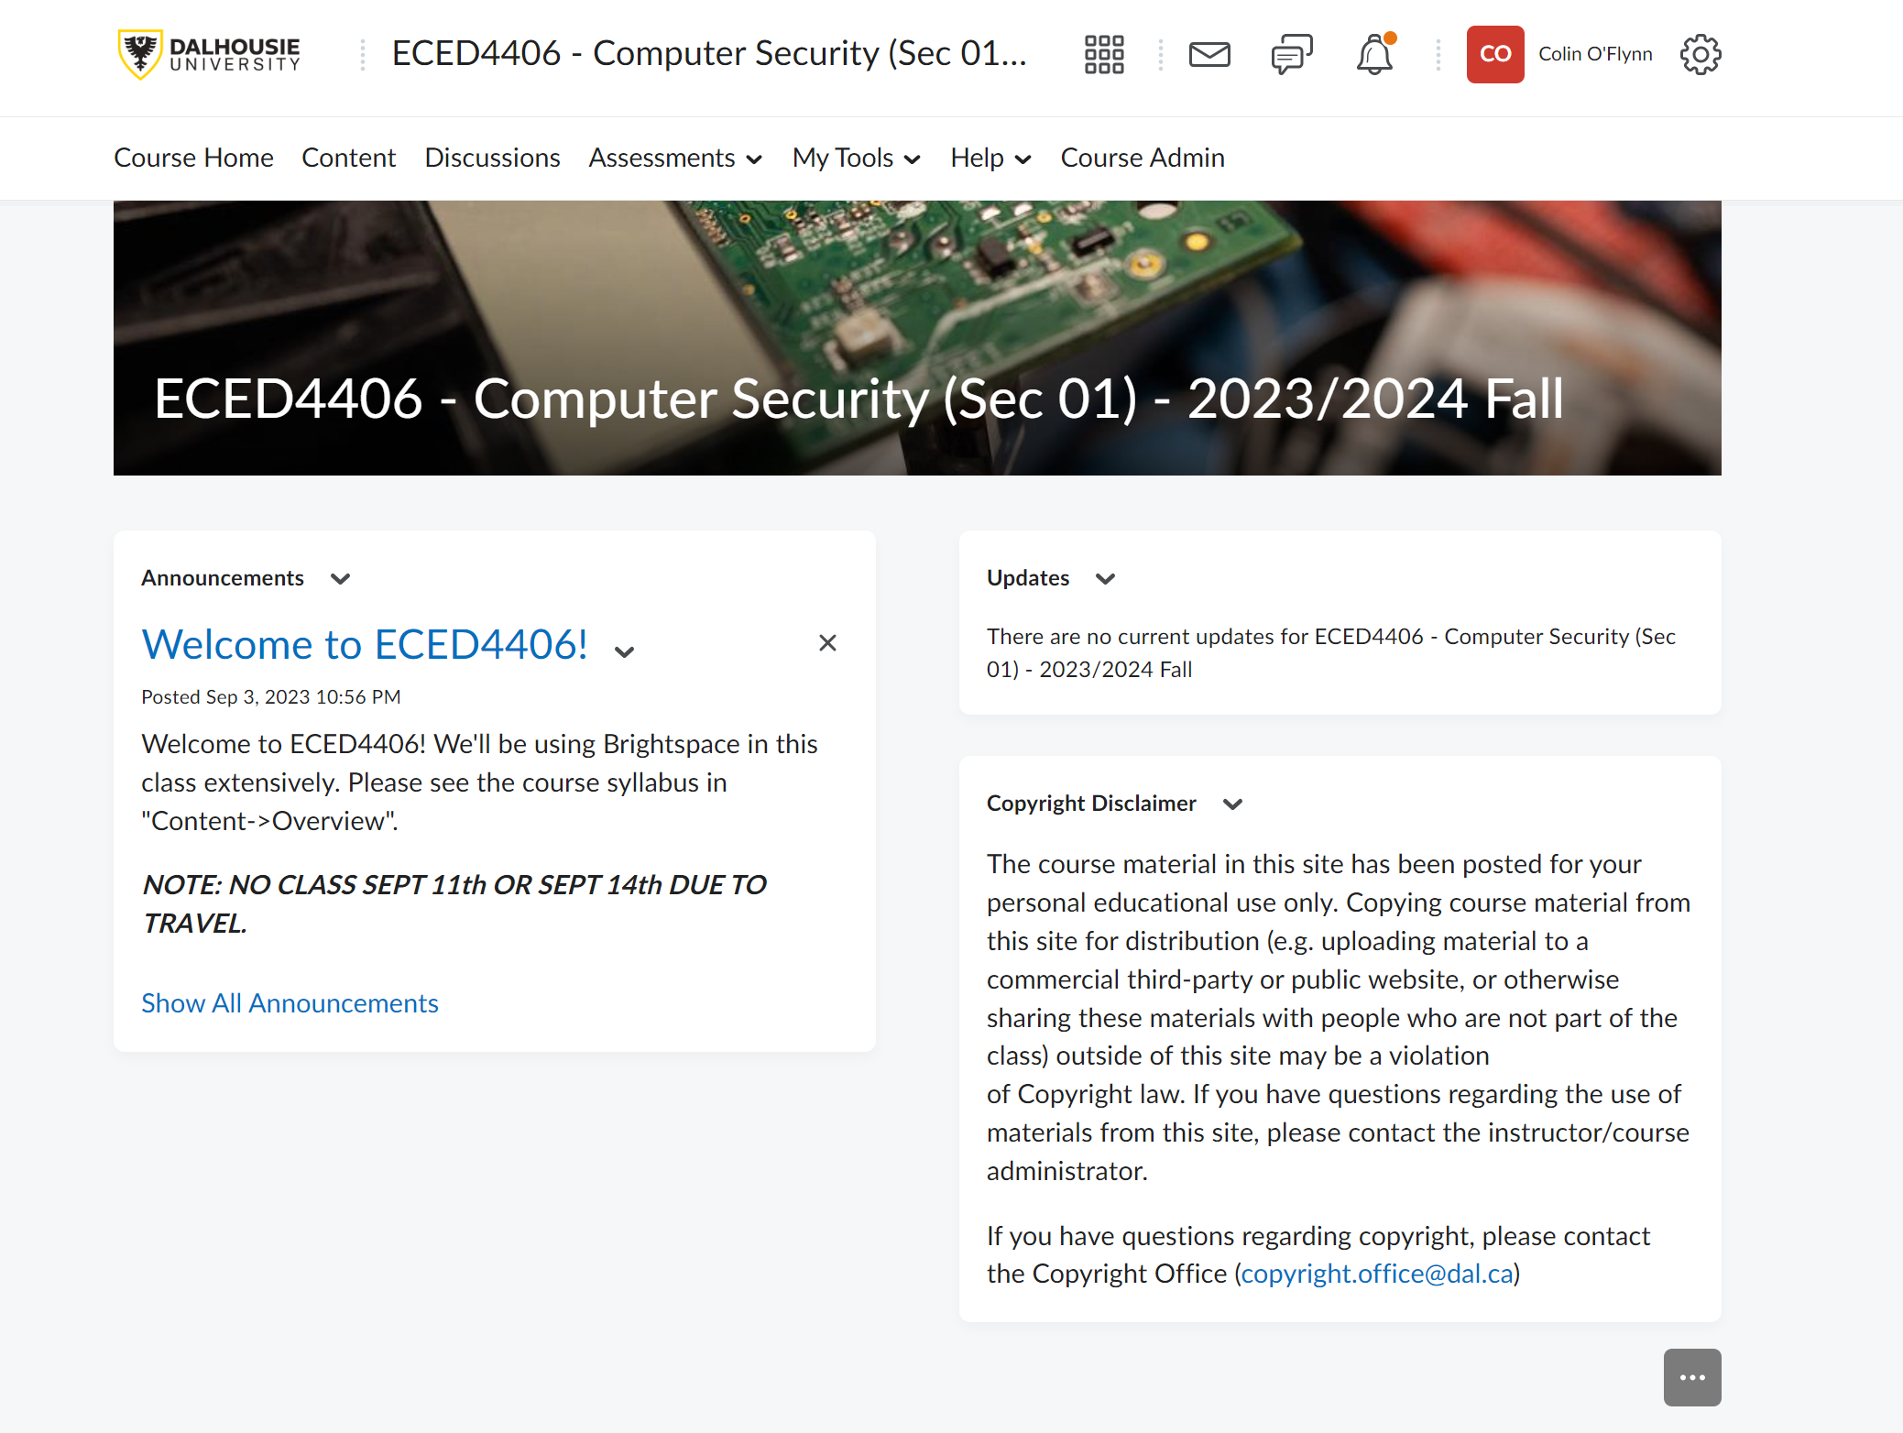
Brightspace

Slide 8
Quizzes
We will start quizzes in 2 weeks (next week – no class) – these cover some of the lecture topics.
They should hopefully reinforce what you’ve learned in the lectures.
They will run through the Brightspace system.

Slide 9
Assignments
Assignments will be throughout the semester
One every ~2-3 weeks in final version to avoid overloading you.

Slide 10
Labs
Labs were previously run on everyone's computers.
We may run them in the lab room.

Slide 11
Course Project
Course project will be a chance to apply some of what you’ve learned in this course.
More details coming next month once you have more background on the material.

Slide 12
Final
Final includes two aspects: a lab test (practical) and a classic written test (during exam time).

